Slide 1
ADSL – Subject Level Analysis Dataset
Anagha Bhatkhande Varsha Mahajan
V 1.0
Effective date: 01-Nov-2017
Copyright © 2016 Tata Consultancy Services Limited
Notes:
Title Slide
Theme Image area
We need to place appropriate image based on the content of the Presentation
Version No
Release date
PALS logo
TCS logo
Theme 1-a
Align text to the bottom of the logo bottom line
Font size 10pt

Slide 2
ADSL : Subject-Level Analysis dataset
ADSL dataset and its related metadata are required in a CDISC-based submission of a clinical trial even if no other ADaM datasets are submitted
The structure of ADSL is one record per subject; for any clinical trial design
ADSL is used to provide key facts about the subject ; enabling analysis and interpretation
ADSL does not contain time varying data and endpoints
ADSL is a source for subject-level variables used in other datasets to enable analysis of the BDS dataset
Only one ADSL per study contains variables integral to design and/or randomization
Structure and content make this analysis dataset a cornerstone for any trial
TCS confidential

Slide 3
ADSL : Subject-Level Analysis dataset
ADSL contains variables such as
Subject-level population flags
Treatment variables – planned and actual
Completion status
Important dates
Disease history
Baseline Information
Demographic variables
Stratification variables
Statistical model covariates
Subgrouping variables etc.
TCS confidential

Slide 4
ADSL : Subject-Level Analysis dataset
Notes:
To create ADSL dataset, it is necessary to review the following sections in SAP to understand how the analysis was planned:
Population definitions
Schedule of assessments
Definition of baseline values
Analysis covariates and
Definition of prior/concurrent medications
The Demographics Domain Model (DM) and Exposure (EX) domains from the SDTM model are typically required
Screen Failures :
Whether analysis datasets include data for subjects not analyzed (e.g., screen failures) is a sponsor decision and should be communicated with the reviewers or users of the data
If these data are included, they should be incorporated in the appropriate analysis datasets such as ADSL (as opposed to separate datasets for non-analyzed subjects) using appropriate flag variables to clearly differentiate these records
The metadata must specify that these data are included and how to distinguish them
TCS confidential
Notes:
The SDTM does not provide a separate domain specifically for screen failure data and does not require that the screen failure data be included in SDTM. Data for screen failure subjects, if submitted, should be included in the SDTM Demographics dataset, with ARMCD = ¨SCRNFAIL" and ARM = ¨Screen Failure”. If Screen Failure is captured as a reason on the End of Study form, Sponsors should also include a record in the Disposition dataset indicating when the screen failure event occurred. Reference the SDTMIG V3.1.2 for further guidance on submitting Screen Failure data.

Slide 5
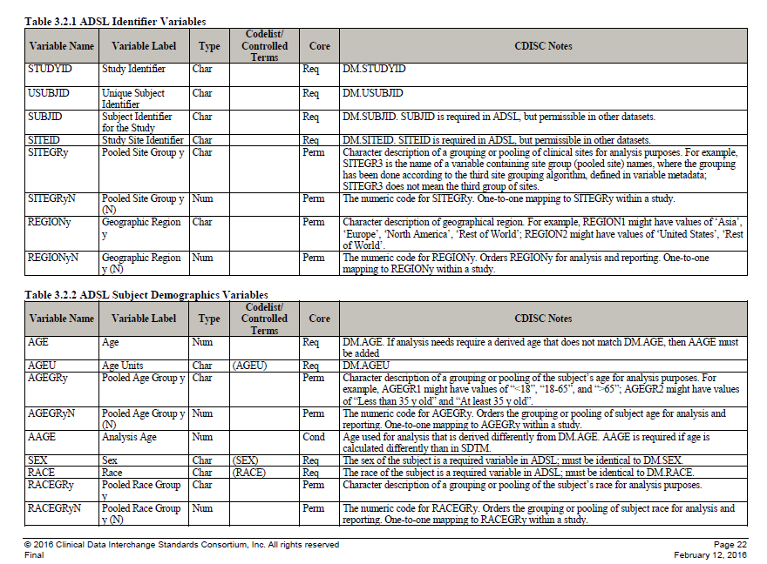
ADSL : Subject-Level Analysis dataset
Must match SDTM variables and values in metadata
TCS confidential

Slide 6
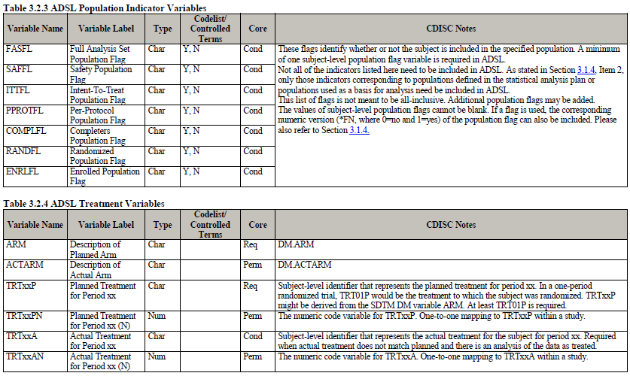
ADSL : Subject-Level Analysis dataset
Must match SDTM variables and values in metadata
Must have at least one population flag
All applicable subject-level population flags must be present
Must have at least one TRTxxP variable
TCS confidential

Slide 7
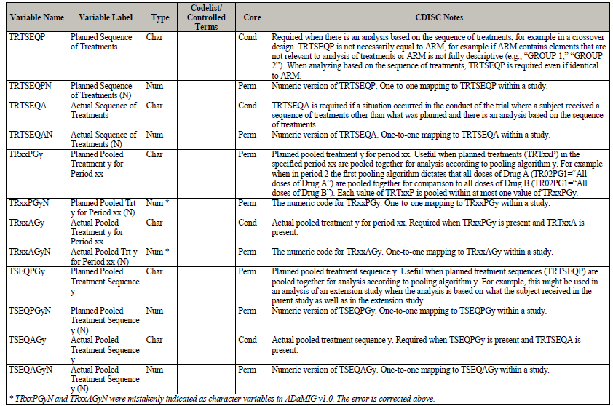
ADSL : Subject-Level Analysis dataset
Added if required as per the study design and analysis
TCS confidential

Slide 8
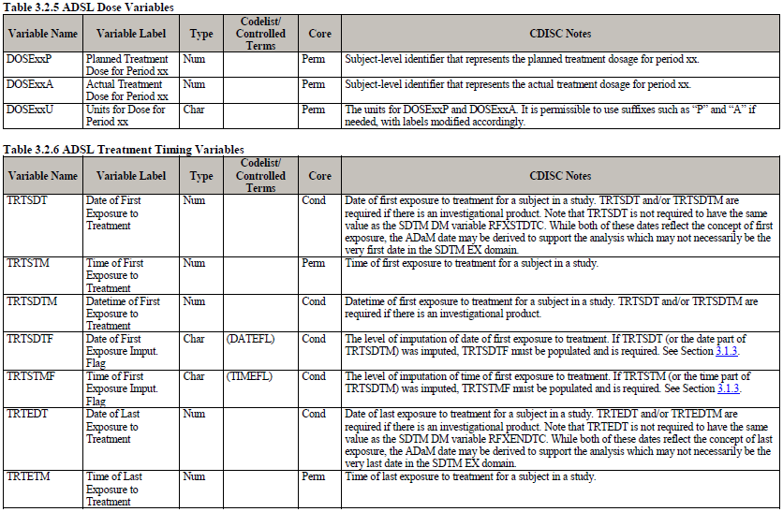
ADSL : Subject-Level Analysis dataset
Selected trial dates required in case of an investigational product
TCS confidential

Slide 9
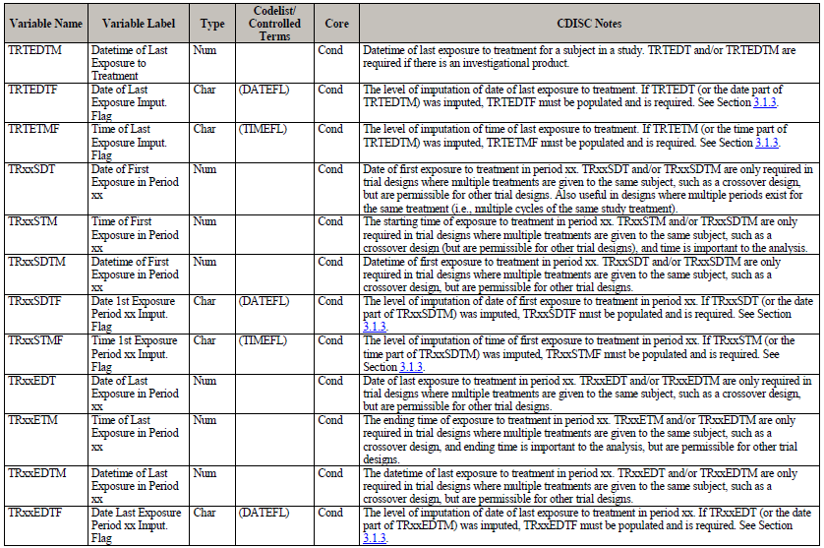
ADSL : Subject-Level Analysis dataset
Added if required as per the study design and analysis
TCS confidential

Slide 10
ADSL : Subject-Level Analysis dataset
Important Notes
A set of timing variables can be included in ADSL only if the definitions are set fixed across the study
Varying timepoint definitions for period start and stop even if required of safety or efficacy analysis should not be included
Additional subject level subperiod, phase timing, trial experience variables can be added
EPOCH variable becomes important to be retained in all ADaM datasets in case of submission
Refer ADaM Implementation Guide V1.1 for all the details
TCS confidential

Slide 11
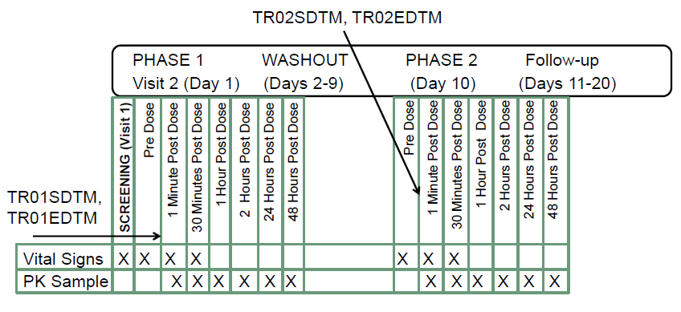
ADSL : Subject-Level Analysis dataset for crossover studies
ADSL variables used effectively in Cross-over studies are:
TRTxxP/TRTxxA, TRxxSDT/TRxxEDT, TRxxSDTM/TRxxEDTM
TCS confidential

Slide 12
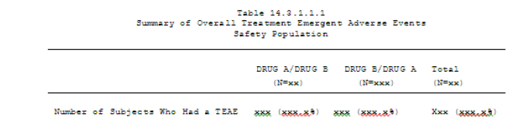
ADSL : Subject-Level Analysis dataset for crossover studies
TRTSEQP &TRTSEQPN / TRTSEQA&TRTSEQAN
Show pre-specified/actual order of drugs received
Used when the summary tables are presented by treatment sequence
ADSL should contain these variables when the statistical analysis models needs the sequence in model statement (e.g. proc mixed) even if the summary reports are presented by treatment received
TCS confidential

Slide 13
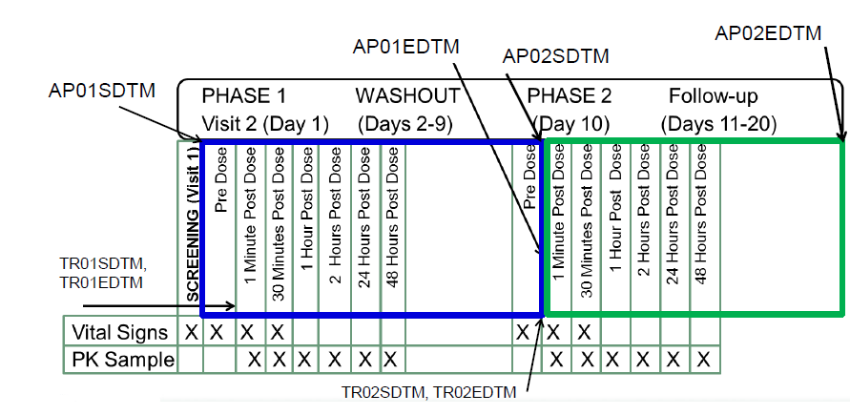
ADSL : Subject-Level Analysis dataset
If a subject in a two period study withdraws before receiving the second treatment
TRT01P/A would contain the planned/actual treatment for the first period
TRT02P would contain the planed second period treatment; TRT02A would be null
TRTSEQP would contain both treatments, in planned order
TRTSEQA would contain only the treatment received
Can create drug-specific start/end datetime variables
Useful in case of any of the flags in ADaM are based on the drug start and end dates rather than the period start and end dates
Create variables containing the start and end date of each period APxxSDT/ APxxSDTM/ APxxEDT/ APxxEDTM if they are not the same as TRxxSDT/TRxxEDT
TCS confidential

Slide 14
ADSL : Subject-Level Analysis dataset
APERIOD will distinguish directly to which period a record relates
Value of the analysis period – does not need to match the protocol period
Should be defined to match Apxxxx values in ADSL
Apxxxx should be wider or equal to TRxxxx values
It is not defined for parts of the study which have no study treatment to be analyzed, so prior to the first treatment analysis period would be null
TCS confidential

Slide 15
ADSL : Subject-Level Analysis dataset
ADSL variables useful for cross-over studies
Category | Variables
Treatment variables | TRTxxP, TRTxxPN, TRTxxA, TRTxxAN, TRxxPGy, PRxxPGyN, TRxxAGy, TRxxAGyN, TSEQPGy (Planned Pooled Treatment Sequence y), TSEQPGyN, TSEQAGy (Actual Pooled Treatment Sequence y), TSEQAGyN, DOSExxP (Planned Dose), DOSExxA, DOSExxU,...
Timing Variables | TRxxSDT, TRxxSTM, TRxxSDTM, TRxxEDT, TRxxETM, TRxxEDTM,...
Period, sub-period, and phase timing variables | APxxSDT, APxxSTM, APxxADTM APxxEDT, APxxETM, APxxEDTM, PxxSwDT, PxxSwTM, PxxSwSDM, PxxSwEDT, PxxSwETM, PxxSwEDM, PHwSDT, PHwSTM, PHwSDTM, PHwEDT, PHwETM, PHwEDTM,
TCS confidential

Slide 16
ADSL : Subject-Level Analysis dataset
ADSL variables useful for cross-over studies
Category | Variables
Trial Experience Variables | EOTxxSTT, EOTxxDT (End of Trt Decision Date in Period xx), EOPxxSTT, DCTxxRS (Reason for Discont of Treat in Period xx), DCTxxRSP (Reason Spec for Disc of Trt in Period xx), DCPxxRS (Reason for Discont from Period xx), DCPxxRSP (Reason Spec for Discont from Study), TRCMP (Compliance with Treatment (%)), TRCMPGRy (Compliance with Treatment (%) Grouping y), TRxxDURD, TRxxDURM (Treatment Duration in Period zz (Mon)), TRxxDURY, RFICyDT, ENRLyDT, RANDyDT, LSTSVDT (Last Subject Visit (SV) Date), LSTALVDT (Last Known Alive Date),
TCS confidential

Slide 17
Example of a crossover study
Assuming that in a two-period cross-over study,
Each subject takes either Drug A or Drug B for four weeks in the first period.
Then each subject takes either Drug B or Drug A for four weeks in the second period.
The duration of the first period is from the first dosing date in the first period to the day prior to the first dosing date in the second period.
The end date of the second period is assumed to be the last treatment date in the second period + 14 days.
After that second treatment period, each subject should have a month of safety follow-up phase
Points to note in the example
Each subject has AP01EDT ≠ TR01EDT and AP02EDT ≠ TR02EDT
E.g. subject 101-01 has TR01EDT = 2015-10-28, but AP01EDT = 2015-10-31, which is TR02SDT - 1. Similarly, TR02EDT = 2015-11-29, But AP02EDT = 2015-12-13.
Defining the start and end dates of each period explicitly makes the definitions of treatment emergent adverse event and concomitant medications much easier.
This approach also improves data-point traceability in BDS datasets including efficacy and safety analysis datasets and OCCDS datasets.
TCS confidential

Slide 18
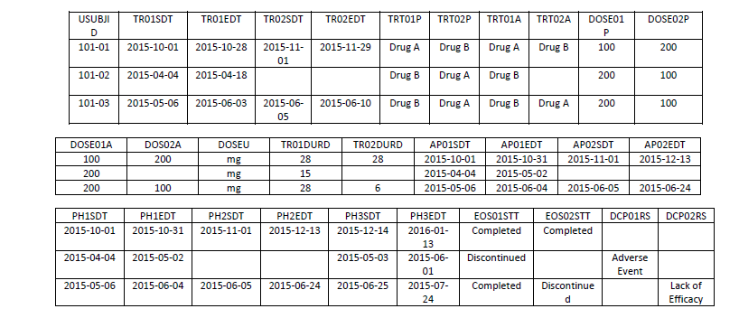
Example of a crossover study
EOS01STT and EOS02STT capture the information of the end of period status.
For instance, subject 101-01 completed both periods (EOS01STT = Completed and EOS02STT = Completed).
Subject 101-02 discontinued in period 1 which can be seen since EOS01STT = Completed.
Subject 101-03 completed the first period and discontinued in the second period (EOS01STT = Completed and EOS02STT = Discontinued).
Planned dose information is captured in variable DOSE01P and DOSE02P and actual dose information is captured in variables DOSE01A and DOSE02A.
The reason for each subject's discontinuation is captured in variables DCP01RS and DCP02RS.
Subject 101-02 discontinued from the study in period 1 due to adverse event. Subject 101-03 discontinued from period 2 due to lack of efficacy.
The treatment duration of each period is captured by variables TR01DURD and TR02DURD
for subject 101-01, treatment durations in Periods 1 and 2 are 28 and 28 days, respectively. For subject 101-003, the treatment durations in Periods 1 and 2 are 28 and 6 days, respectively.
Treatment start and end different from period start and end
Period 2 treatment not taken hence planned treatment recorded and actual missing
Data snapshot
Why not use AP03SDT and AP03EDT to represent the start and end dates of the follow-up period?
The reason of not using variables APxxSDT and APxxEDT is that xx need be associated with treatment variables TRTxxP and TRTxxA.
But there is no treatment associated with the follow-up phase.
Similarly, if a subject need to define the start and end dates of a screening phase, one can also use PHySDT and PHyEDT.
In order to capture the follow-up phase start and end dates, variables PHySDT and PHyEDT are introduced.
TCS confidential

Slide 19
References
Reference
Reference
Reference
Reference
Reference
Reference
Notes:
Content Slide- 2 row / comparison

Slide 20
Thank You
For any feedback/comment/clarification please contact us at PALS@tcs.com
V NN

Slide 21
Document Release Notice
This XXXXXXX, Version NN, is released for use in Tata Consultancy Services (TCS) with effect from – DD-Mmm-YYYY.
This Training Material is subject to TCS Document Control Procedure. TCS reserves the right to make additions, modifications or alterations to the existing content or release a newer version of this document.
Softcopy of the latest version of the document is available in the ABCDEFG
Comments suggestions or queries should be addressed to PALS@tcs.com.
Date: DD-Mmm-YYYY
Date: DD-Mmm-YYYY
Document Name
Effective Date: DD-MMM-YYYY
V NN
Notes:
Font size 9pt

Slide 22
Change/Revision History
Version No. | Revision Description | Slide No. | Rationale for the Change | Change type (Add/Modify/Delete) | Modified By | Date Modified (DD-Mmm-YYYY)
V NN

